Slide 1

PERSONAL Loan default prediction by Dewiana
11 Jun 2025
Minimizing risk through early assessment of customer profiles

Slide 2
INTRODUCTION
Singapore Ministry of Law reported a notable 23.6% increase in individual bankruptcy cases in 2024.
American owed approx. $251 billion personal loan debt by Q4 2024.
Bank / Financial Institution may face the risk of loan default.
A model has been built to minimize the loss due to loan default.
Notes:
Late installment, financial difficulty experienced within 1 year installments
Company reject potential customer, loss of business.

Slide 3
PROBLEM STATEMENT
Can banks identify personal loan default risk at customer onboarding?

Slide 4

Context
Several customers have defaulted after settling only 30-40% of loan installment during the loan tenure.
In some cases, customers have declared bankruptcy.
Currently, there is no model in place to evaluate default risk at onboarding.
Current Business Challenge

Slide 5

Context
Input: Loan officer enters customer profile into model → Model Output: Probability of loan default (Default / No Default)
Success Metrics:
Fewer defaulting customers onboarded,
Higher rate of fully settled loans
Defining Success

Slide 6

OBJECTIVES
What: Onboard customers with minimum default risk
Why: Reduce the risk of loss to banks/financial institutions
Who: Banks/financial institutions – especially loan department offering personal loan

Slide 7

Data limitations
No time features (e.g. loan start date or default date)
Co-signer treated as non-joint borrower

Slide 8
Data cleaning and preparation
No. | Step | Further Details
1 | Remove Duplicates | None
2 | Handle Nulls | None
3 | Dropped Columns | HasCoSigner (co-signer not joint borrower)*
4 | Conversion of Data Type | Converted DEFAULT from binary to boolean
Total Rows= 255347
Total Columns= 18
*Cosigner: not considered as main borrower. The person’s creditworthiness is not taken into consideration in the process of onboarding.

Slide 9
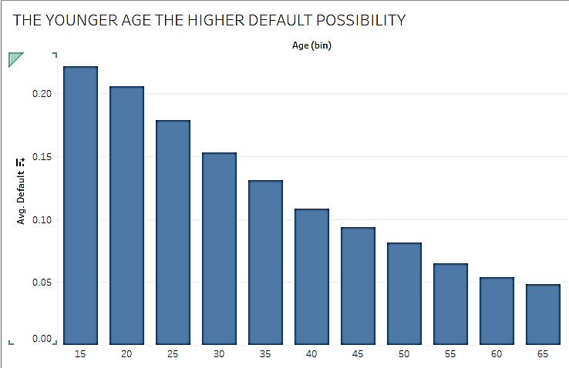
EDA - INSIGHTS
Younger borrowers have higher default risk
Potential Causes
>3x higher default rate by 15-20 year olds compared to 60-65 year olds.
Lower financial discipline

Slide 10
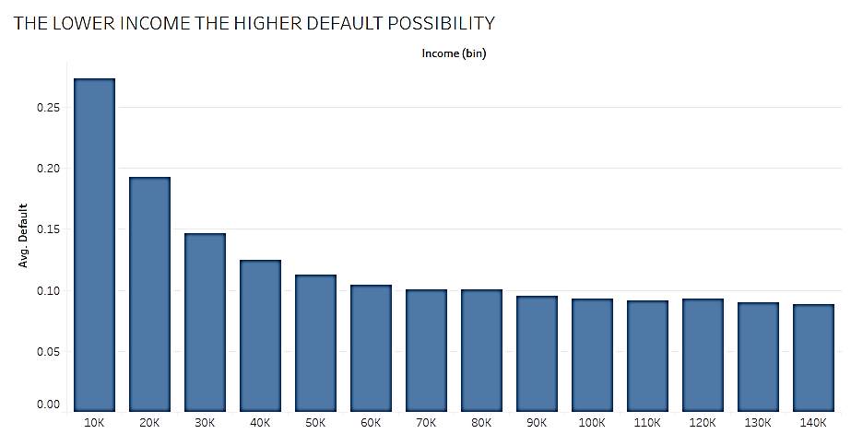
EDA - INSIGHTS
Lower-income borrowers are more likely to default.
Significantly higher risk of defaulting
Create a risk buffer threshold (e.g. minimum income of $3,000/month).

Slide 11
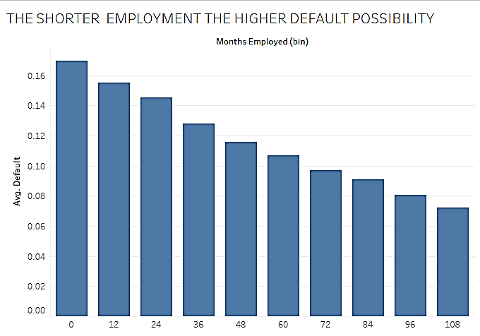
EDA - INSIGHTS
Shorter employment history has a higher rate of defaulting.
Potential Causes
Unstable Income

Slide 12
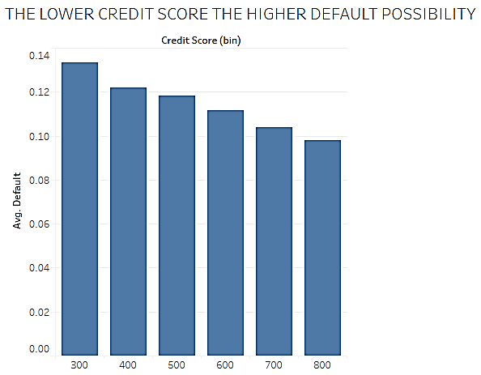
EDA - INSIGHTS
Credit score is a strong predictor of default risk.

Slide 13
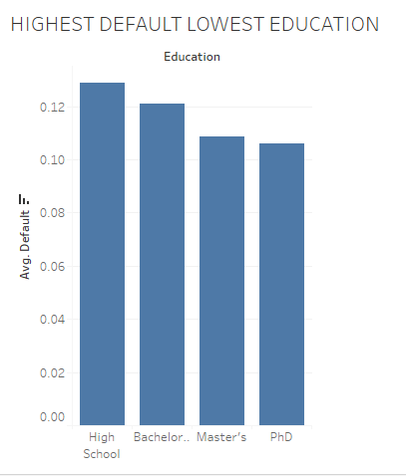
EDA – INSIGHT
Lowest education highest default possibility

Slide 14
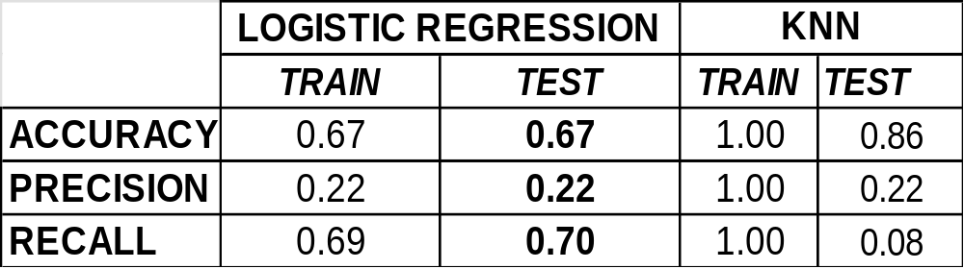
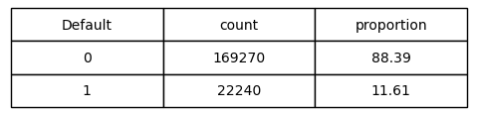
Model PERFORMANCE comparison & selection
Analyzing Logistic Regression vs KNN
Imbalance classification
Acc. : how often the model is correct
Prec.: how freq. are default predictions confirmed in reality?
Recall : finding real defaulter.
Logistic Regression is chosen for this initial model (accuracy and recall).

Slide 15


Model
Mock decision pipeline of a loan application
Bank Officer enters customer data into the model
Run the model
If result = TRUE,
possibility of default is detected
Reject application
If result = FALSE, possibility of default is not detected
Approve Application /Proceed further

Slide 16
Conclusion
Can we predict default risk at onboarding?
Yes — the model helps assess risk of default using customer profile
at the application stage.
However, more improvements can be made on the model.

Slide 17

Recommendations
Actionable ideas for further development
Develop a more advanced model for easier and faster use
Add features to the model for greater purpose (e.g. loan disbursement date, default date, customer’s asset ownership)
Maintain list of default case detail.
Tailored loans for rejected applicants
(e.g., smaller loans, higher interest for borderline customers)

Slide 18
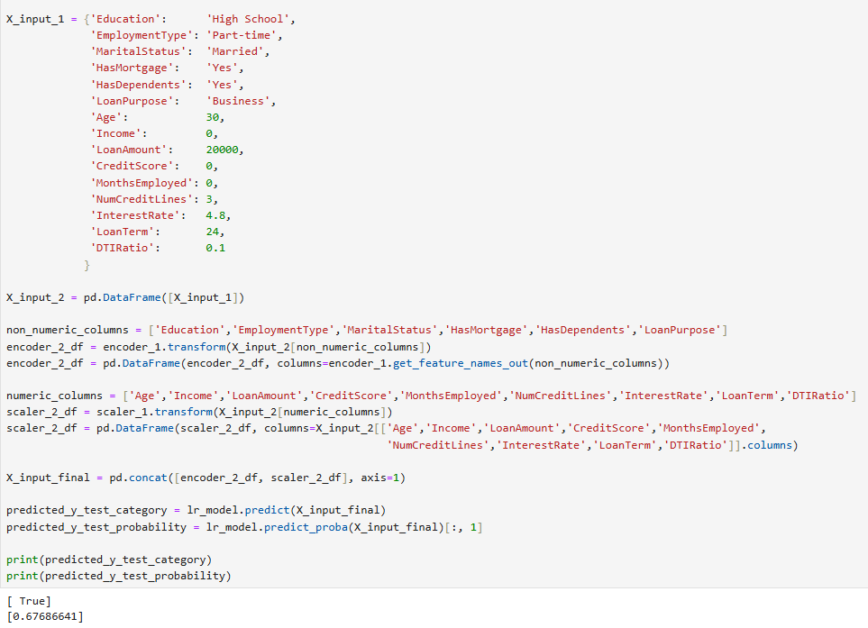
INPUT MODEL

Slide 19
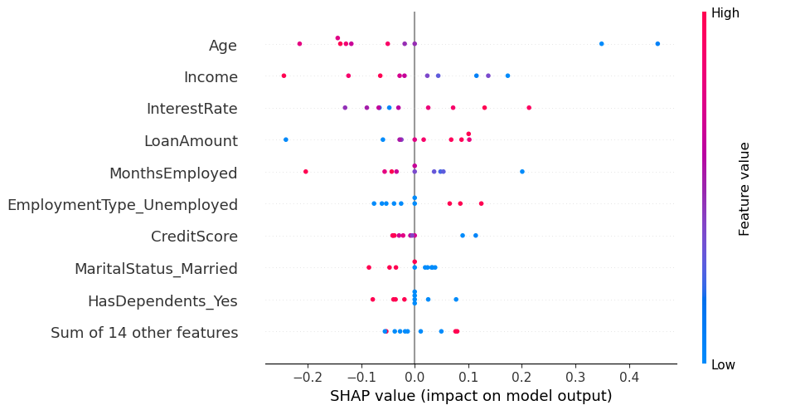
Important insights
Highlighting features that increase default risk.

Slide 20
Data Sources
Personal Loan
https://www.kaggle.com/datasets/nikhil1e9/loan-default
Singapore Ministry of Law – Insolvency Office report in individual bankruptcy cases in 2024. https://io.mlaw.gov.sg/files/IID%20Statistics%20/NumberofBankruptcyApplicationsOrdersMadeandDischarges_April2025_.pdf

Slide 21
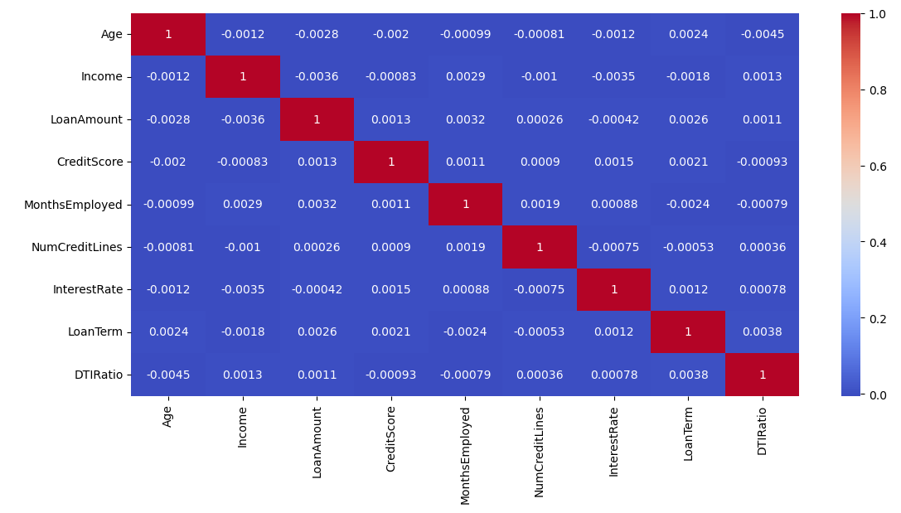
NUMERIC HEATMAP

Slide 22
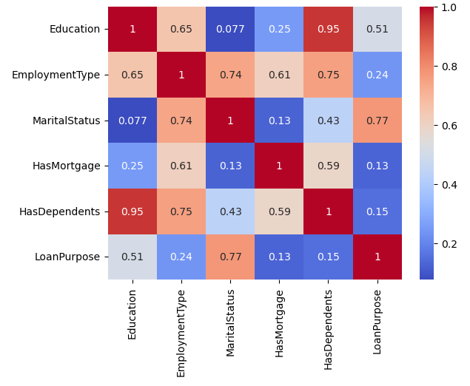
NON-NUMERIC HEATMAP

